Slide 1
Lending Club Case Study

Slide 2
Project analysis slide 6
Background &Problem Statement
This company is the largest online loan marketplace, facilitating personal loans, business loans, and financing of medical procedures.
Borrowers can easily access lower interest rate loans through a fast online interface.
Lending loans to ‘risky’ applicants is the largest source of financial loss (called credit loss).
Identification of risky loan applicants in advance can reduce credit loss.
Identification of risky applicants using EDA is the aim of this case study.
Company wants to understand the driving factors (or driver variables) behind loan default.

Slide 3
Project analysis slide 2
Solution Approach
Bivariate Analysis
Data Sourcing
Lending Club EDA
Univariate Analysis
Data Cleansing
Derived Metrics
Data Transformations

Slide 4
Project analysis slide 3
Data Cleansing
All Null Values
Unique value count
Remove out of scope columns
Final Column Count
Dependent Variable filter
All IDs can be removed as it is unique and will not give any useful insights. Also there are certain features which captures information after awarding the loan.
Business objective is to find out the likely defaulters or people who pay back full amount.
So we need to focus on observations having loan_status as "Fully paid" or "Charged off". From a business objective standpoint loan_status value "Current" is not having any significance
Removed columns with all null values. There are around 54 columns with all values as NA
If the count is very less or huge it may not be very useful for analysis. So these columns have been removed
Our final data set is having 20 columns and it consists of customer attributes while applying loan and also loan attributes.

Slide 5
Project analysis slide 3
Variable Types
All variables (Independent Variables) can be classified into 3 categories. Some example fields against each categories are captured below
Customer Demographic
Loan Information
Customer Behavior Variables
Loan Amount
Funded Amount
Interest Rate
Grade
Sub Grade
Delinquency year
Earliest Credit line
Revolving Balance
Recoveries
Application Type
Employment Length
Employment Title
Annual Income
Home_ownership
Customer behavior variables are not available at the time of loan application, and thus they cannot be used as predictors for credit approval. Hence we have removed Customer behavior variables from our data.

Slide 6
Univariate Analysis

Slide 7
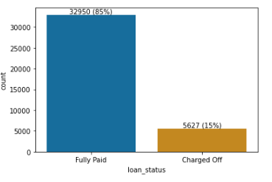
Project analysis slide 3
Loan Status
TECHNICAL ANALYSIS
FINANCIAL ANALYSIS
Average default rate is around 15 %

Slide 8
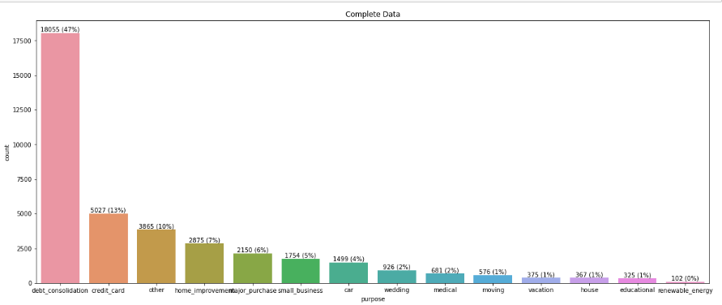
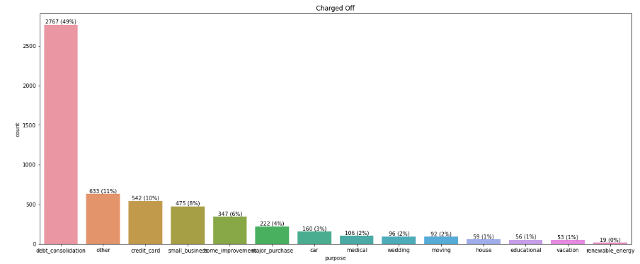
Project analysis slide 3
Loan Purpose
TECHNICAL ANALYSIS
FINANCIAL ANALYSIS
ECOLOGICAL ANALYSIS
Major purpose of the loan are ::
debt_consolidation, credit_card, other, home_improvement, major_purchase, small_business, car
Order changed slightly for only Charged off cases ::
debt_consolidation, other, credit_card, small_business , home_improvement, major_purchase, car
small_business, debt consolidation, other categories percentage increased when we restrict the data set to "charged off".
So closer inspection is required before providing the loan for these purposes.

Slide 9
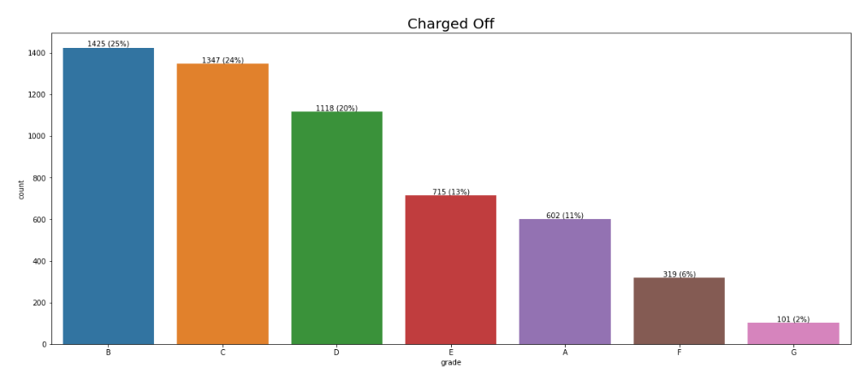
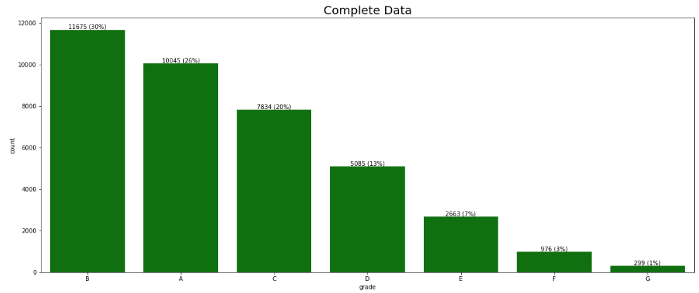
Project analysis slide 3
Grade
TECHNICAL ANALYSIS
FINANCIAL ANALYSIS
ECOLOGICAL ANALYSIS
Almost 90% of loans are in Grades B, A, C, D
% of defaulters with respect to total number are less in Grade A compared to other Grades

Slide 10
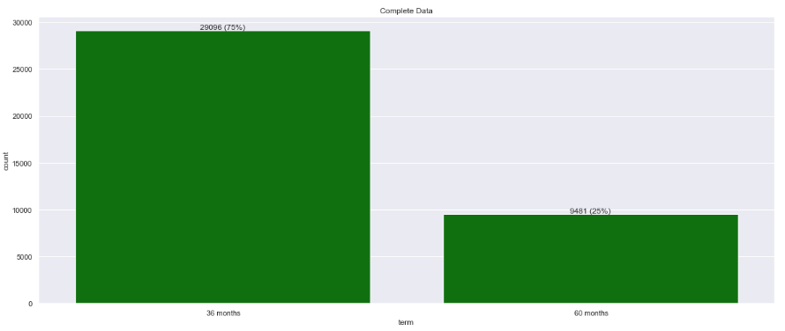
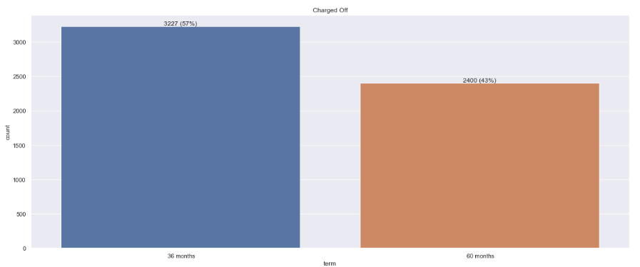
Project analysis slide 3
Term
TECHNICAL ANALYSIS
60 month terms are 25% of the total records but when it comes to defaulters the percentage increased to 43%.
Company should be more careful while awarding 60 months loan term.

Slide 11
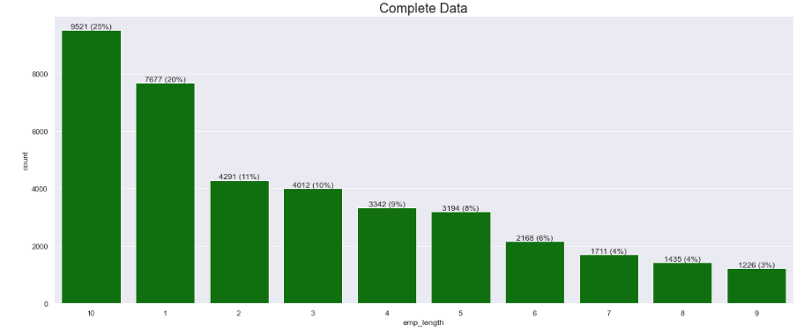
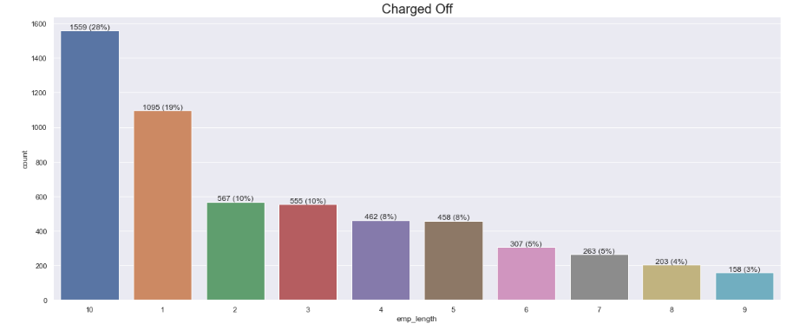
Project analysis slide 3
Employment Length
TECHNICAL ANALYSIS
FINANCIAL ANALYSIS
People with 1 year and 10 year experience are taking loans more frequently and they are the most defaulters also

Slide 12
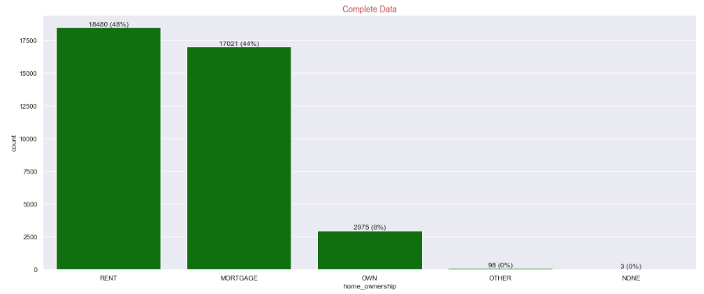
Project analysis slide 3
Home Ownership
FINANCIAL ANALYSIS
Loan applicants from people who owns a home are comparatively less

Slide 13
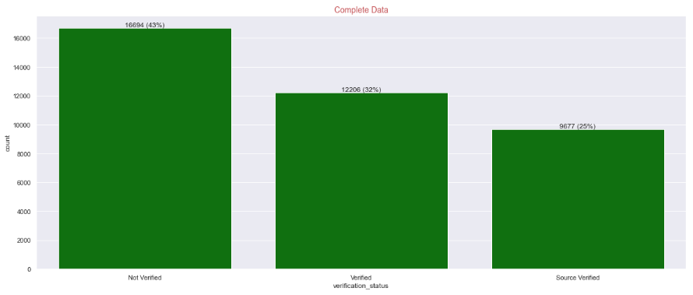
Project analysis slide 3
Verification Status
FINANCIAL ANALYSIS
43% Loans are being issued even if the income is not verified

Slide 14
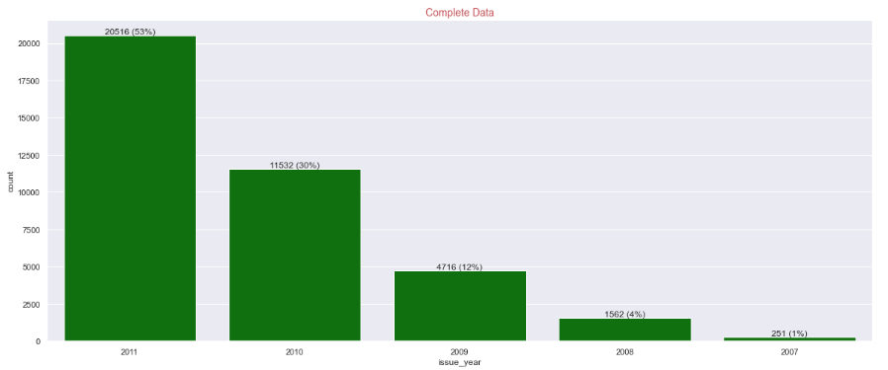
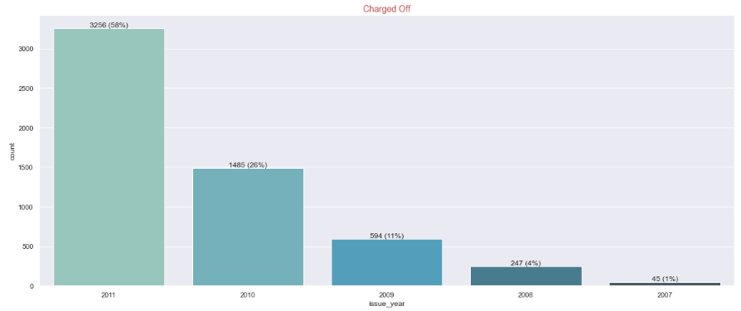
Project analysis slide 3
Loan Issue Year
FINANCIAL ANALYSIS
There is a consistent increase in loan applicants each year. Number of defaulters are increasing every year more than double in comparison with previous year

Slide 15
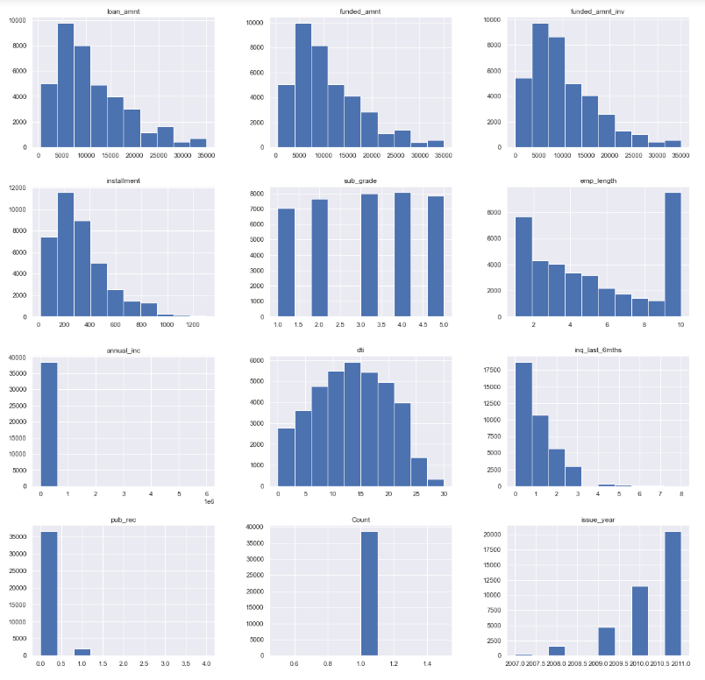
Project analysis slide 3
Numeric Variable Distribution
75 % of loan amount request are for less than 15000
dti is almost normally distributed
It is very evident that there are some outliers in Annual income
FINANCIAL ANALYSIS

Slide 16
Derived Metrics

Slide 17
Project analysis slide 3
Derived Metrics
Since we have Loan Amount and Annual income fields , we can find out a new ratio Loan to Annual Income which will be helpful in our further analysis
Created a new column captures dti range
low – Less than or equal to 10
medium – Greater than 10 and less than or equal to 20
high – Greater than 20
Loan to annual income range has been created
low – Less than or equal to 0.15
medium – Greater than 0.15 and less than or equal to 0.25
high – Greater than 0.25
Employee length range has been created
low – Less than or equal to 4
medium – Greater than 4 and less than or equal to 8
high – Greater than 8
FINANCIAL ANALYSIS

Slide 18
Bivariate Analysis

Slide 19
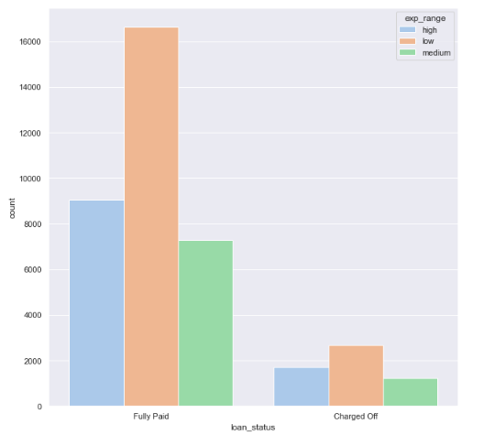
Project analysis slide 3
Loan Status vs Experience
FINANCIAL ANALYSIS
people with less experience are having high chance of default

Slide 20
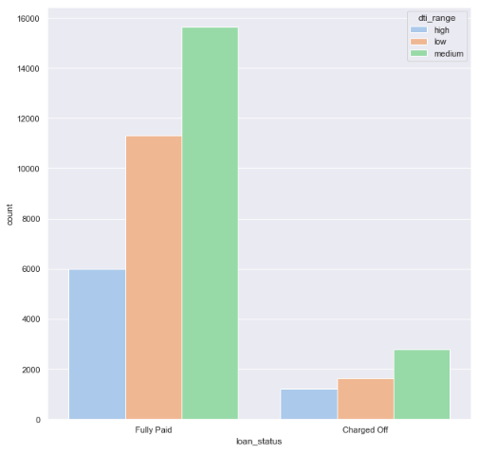
Project analysis slide 3
Loan Status vs dti Range
FINANCIAL ANALYSIS
People in Medium dti range is taking more loans and proportionately default rate is also high in medium range

Slide 21
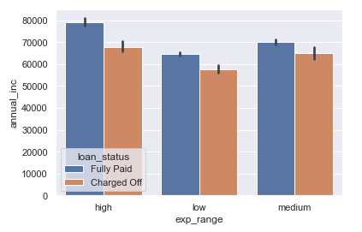
Project analysis slide 3
Annual Income vs Experience
We compared Annual Income and experience within the purview of loan status.
FINANCIAL ANALYSIS
Average Annual income of Fully paid applicants are always higher across experience range

Slide 22
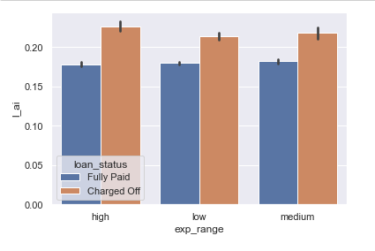
Project analysis slide 3
Loan to Annual Income Vs Experience
We compared Loan to Annual Income Ratio and experience within the purview of loan status.
FINANCIAL ANALYSIS
Average Loan to annual income ratio is always higher in charge off applicants across experience range

Slide 23
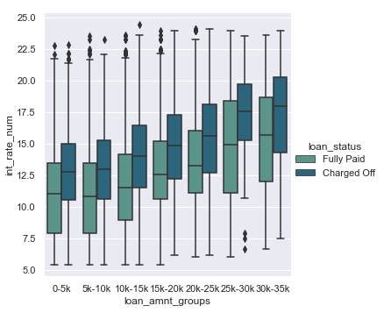
Project analysis slide 3
Interest Rate Vs Loan Amount Group
We compared Interest Rate and Loan Amount Group within the purview of loan status.
FINANCIAL ANALYSIS
Interest rate distribution of Charged off loans are consistently higher across loan amount groups

Slide 24
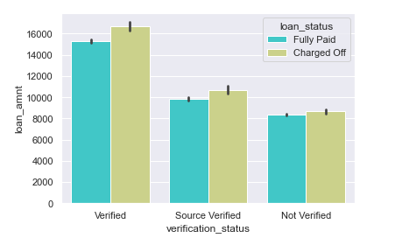
Project analysis slide 3
Loan Amount vs Verification
We compared Loan Amount and Verification status within the purview of loan status.
FINANCIAL ANALYSIS
Loan amount of verified sources are higher. Either company is approving higher loan amounts after verification or Priority verification is being done on higher amount loans.

Slide 25
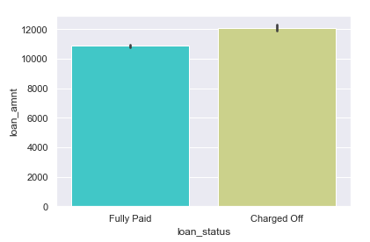
Project analysis slide 3
Loan Amount vs Loan Status
We compared Loan Amount and Loan status.
FINANCIAL ANALYSIS
Average loan amount of Charged off group is higher than Fully paid. This means tightening of loan amount eligibility scrutiny is required.

Slide 26
Deductions from EDA

Slide 27
Project analysis slide 3
Inferences & Recommendations
Average default rate is around 15%
Loan default percentage increase for purposes small_business, debt consolidation, other categories when we restrict the data set to "charged off". So closer inspection is required before providing the loan for this purpose
60 month terms are 25% of the total records but when it comes to defaulters the percentage increased to 43%. Company should be more careful while awarding 60 months loan term
% of defaulters with respect to total number are less in Grade A compared to other Grades
People with 1 year and 10 year experience are taking loans more frequently and they are the most defaulters also.
Loan applicants from people who owns a home are comparatively less. So it is less risky to award loan to a home owner.
43% Loans are being issued even if the income is not verified
There is a consistent increase in loan applicants each year. Number of defaulters are increasing every year more than double in comparison with previous year
75 % of loan amount request are for less than 15000
People with less experience are having high chance of default
People in Medium dti range is taking more loans and proportionately default rate is also high in medium range
Average Annual income of Fully paid applicants are always higher across experience range. It is comparatively less risky to give loan to people having high annual income.
Average Loan Amount to annual income ratio is always higher in charge off applicants across experience range.
FINANCIAL ANALYSIS

Slide 28
Thank You

